Slide 1
GDMR – SHOPPER STOP CITY CENTRE –RECCE REPORT

Slide 2
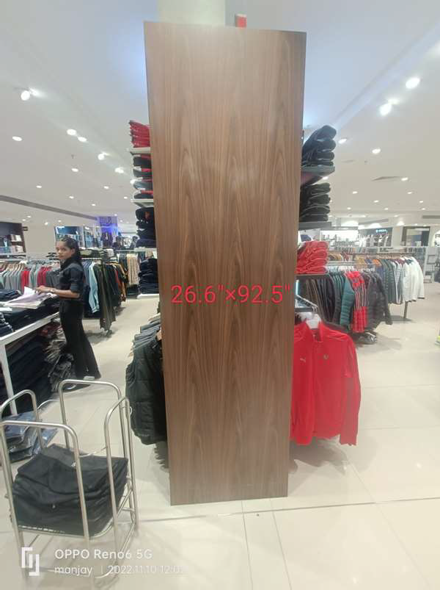
26.6 x 92.5

Slide 3
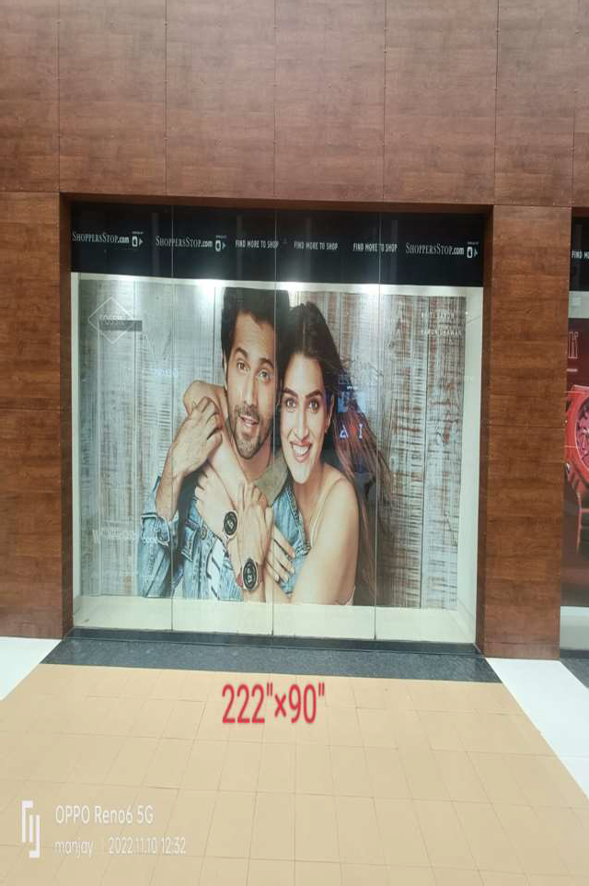
222 x 90

Slide 4
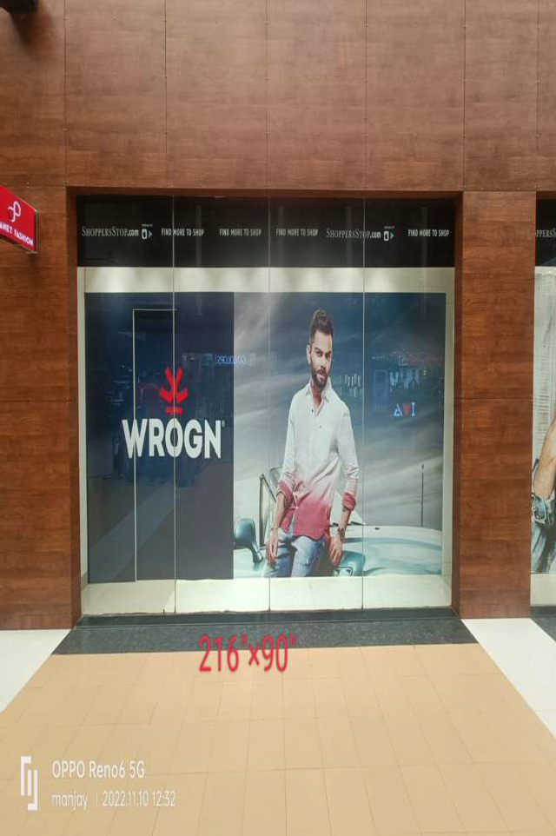
216 x 90

Slide 5
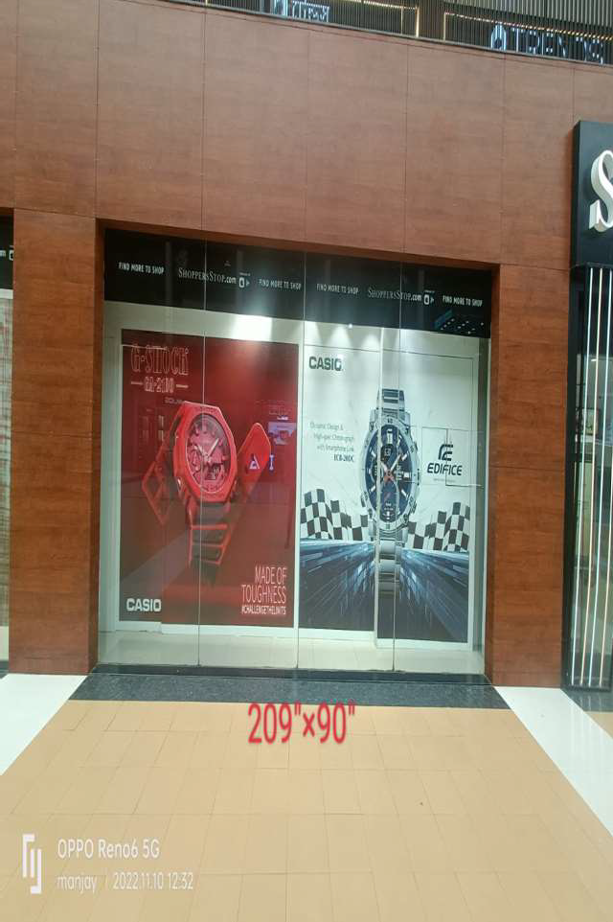
209 x 90

